Slide 1


Object-Oriented Principles
Endre Ferencz
Endre_Ferencz@epam.com
2015

Slide 2

Agenda
Introduction
Design UML Class diagram
Object-Oriented Principles
Redesign the Class diagram

Slide 3
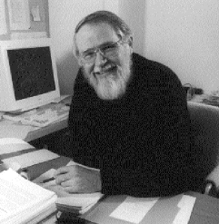
Before we start
Controlling complexity is the essence of computer programming
Brian Kernighan

Slide 4

Introduction
Object-Oriented Principles

Slide 5

What's the point of OOP?
I don't think object-oriented programming is a structuring paradigm that meets my standards of elegance (1999)
Edsger Dijkstra

Slide 6
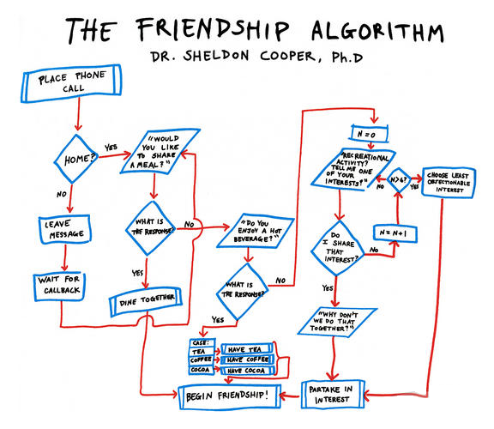
Functional decomposition
Notes:
A natural way to deal with complexity.
Task: writing code to access a description of shapes that were stored in a database and then display them
Steps:
1. Locate the list of shapes in the database.
2. Open up the list of shapes.
3. Sort the list according to some rules.
4. Display the individual shapes on the monitor.
Break down the steps:
4a. Identify type of shape.
4b. Get location of shape.
4c. Call appropriate function that will display shape, giving it the
shape’s location.

Slide 7

The challenge
Dealing with change:
Notes:
Change creates opportunities for mistakes and unintended consequences.

Slide 8

Things change
Requirements always change
And nothing you can do will stop change…
… but you do not have to be overcome by it
Notes:
You can never get all of the requirements from the user.
Too much is unknown about the future.
Rather than complaining about changing requirements, we should change the development process so that we can address change more effectively.

Slide 9
Solution: Modularity
Using modularity to contain variation
main
data
module1
module2
module3
data
data
data
Notes:
Rather than writing one large function, I could make it more modular.
Isolate the problem.
Then, when I receive a requirement to be able to display a new type of shape—a triangle, for instance—I only need to change this module (hopefully!).
Modularity definitely helps to make the code more understandable.

Slide 10
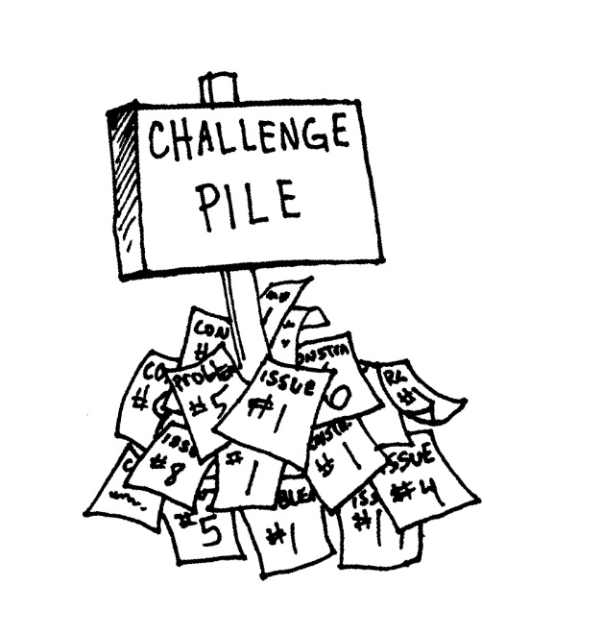
Challenge pile
Low cohesion
the operations in a module are not closely related
Tight coupling
the connection is too strong between the modules
Notes:
Unexpected impact.
Cohesion:
Coincidental cohesion (worst)
Logical cohesion
Temporal cohesion
Procedural cohesion
Communicational/informational cohesion
Sequential cohesion
Functional cohesion (best)

Slide 11
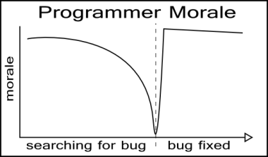
Bugs
Changing a function, or even data used by a function, can wreak havoc on other functions
The devil is in the side effects
We really do not want to spend too much time fixing bugs
Notes:
Task: make sure everyone knows how to get to their next class
SolutionModular:
1. Get list of people in the class.
2. For each person on this list:
2a. Find the next class they are taking.
2b. Find the location of that class.
2c. Find the way to get from your classroom to the person’s next class
2d. Tell the person how to get to their next class.
You have to pay close attention to a lot of details!

Slide 12

The object-oriented way
Shifting responsibility from yourself to individuals
Can localize changes
Notes:
SolutionOO: I have posted the locations of the classes following this in the back of the room, as well as the locations of the other classrooms. Please use them to go to your next classroom.
Give general instructions and then expect that each person will figure out how to do the task himself or herself.
The objects
Are responsible for themselves
Shift responsibility to a more local level
The control program can talk to different types of objects uniformly
The control program does not need to know about the special steps

Slide 13
The object
Abstract
Conceptual level
set of responsibilities
Specification level
a set of methods
Implementation level
code and data
Concrete

Slide 14
Design Approach
Responsibility-driven design
Delegated control
Coordinators
Higher-level messages
Few smart objects
Rule-Based Design
Artificial intelligence applications
Event-Driven Design
Asynchronous environment
Triggers fired on incoming events
Extreme loose coupling
Data-Driven Design
Centralized control
Controllers
Low-level messages
Lots of simplistic information holders
Ad-Hoc Design
Non-generalizable

Slide 15
Software quality, External factors
Correctness: perform the exact tasks defined by the specification
Robustness: react appropriately to abnormal conditions
Extendibility: adaptability to changes of specification
Maintainability: ease of modification, understandability
Reusability: elements serve for the construction of different applications
Functionality: extent of possibilities provided by a system
Compatibility, portability, ease of use
Performance

Slide 16
Exercise
Object-Oriented Principles

Slide 17
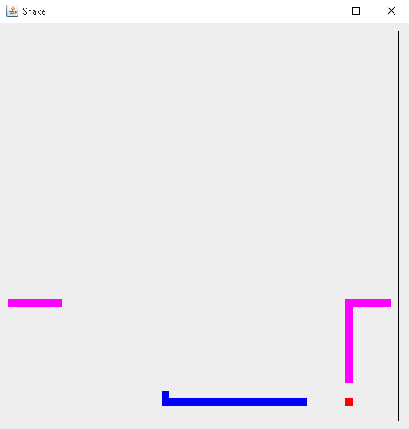
Snake application
The snakes are controlled by different algorithmic strategies

Slide 18
Object-oriented Principles
Object-Oriented Principles

Slide 19
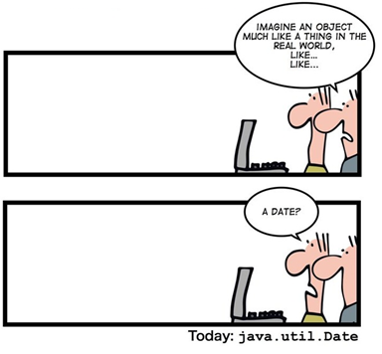
Core OO concepts
Abstraction
Polymorphism
Inheritance
Encapsulation and Information hiding

Slide 20

Encapsulation and Information hiding
Encapsulation
Bundle data with the operations
Information hiding
Hiding implementation details (not just the attributes)
Hiding internal concepts
Protect components of the object from external entities

Slide 21
Abstraction
Definition
Preserving information that is relevant in a given context, and forgetting information that is irrelevant in that context
Object-Oriented Analysis and Design with Applications, Addison-Wesley

Slide 22

Usage of Abstraction
Managing complexity
Modeling a concept
Use abstractions whenever suitable in order to avoid duplication
Represent an unbounded group of possible behaviours
Abstract entities are the most stable in the system
Gerhard Richter's "Abstraktes Bild (804-9)"

Slide 23

Inheritance
Deriving a new class from an existing one
Strongest relationship between classes
Usage
Mechanism for code reuse
Establishes an is-a relationship
Allow independent extensions of the original class

Slide 24
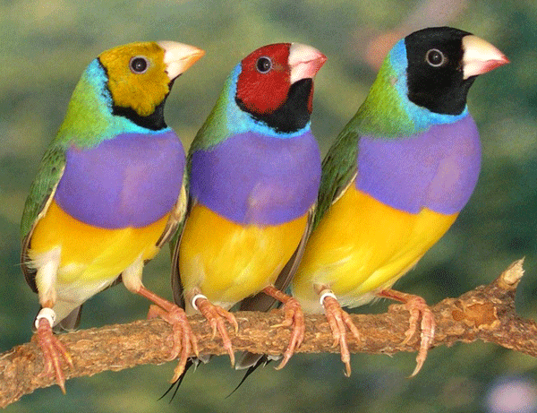
Polymorphism
From Greek
polys: "many, much"
morphē: "form, shape“
Kinds of polymorphism
function overloading
generic programming
function override (OO polymorphism)
OO polymorphism
Provision of a single interface to entities of different types

Slide 25
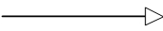
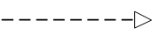


Possible relationships
Inheritance
Implementation
Composition
Aggregation
Association
Dependency
extends
implements
~ field
~ may be affected

Slide 26
Multiple inheritance
Solution: Java interface
Method declarations
No fields, no implementation
(default methods from Java 8)
Person
Student
Employee
Trainee
Diamond problem

Slide 27
Inheritance vs. Composition
Prefer composition over inheritance
Strive for loosely coupled components
Isolate changes
Composition may change dynamically (relationship between objects)
HAS-A can be better than an IS-A relationship
Drawbacks
Additional complexity (dynamic relationship)
May be an imperfect design
Person
Student
Student
Person

Slide 28

Coupling and Cohesion
Coupling
Changing one module in a program requires changing another module
Cohesion
Degree to which the elements of a module belong together
High cohesion often correlates with loose coupling

Slide 29
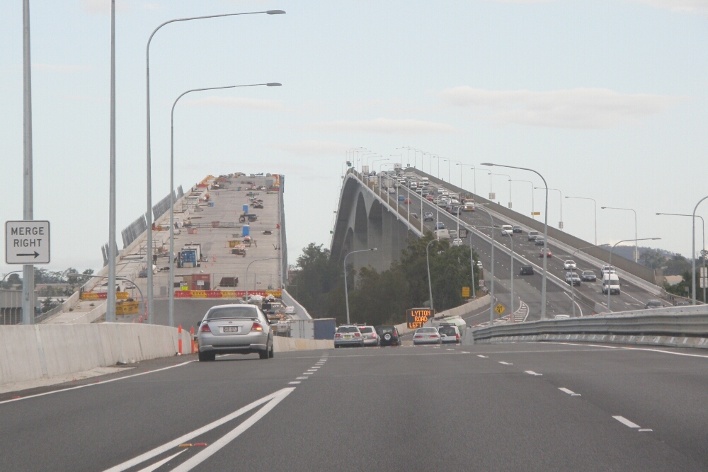
Exercise
Analyze the dependencies in the given project
Refactor the code

Slide 30
SOLID principles
Object-Oriented Principles

Slide 31
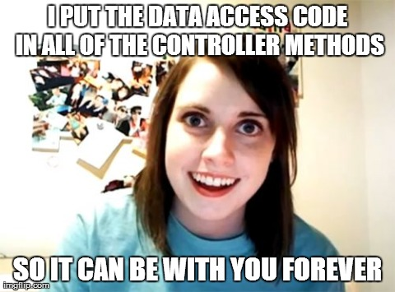
SOLID principles
Single responsibility principle
Open/closed principle
Liskov substitution principle
Interface segregation principle
Dependency inversion principle

Slide 32
Single responsibility principle
Every class should have a single responsibility, and that responsibility should be entirely encapsulated by the class
The class should have one, and only one, reason to change
Motivation
Make the class more robust
Avoid coupled responsibilities

Slide 33
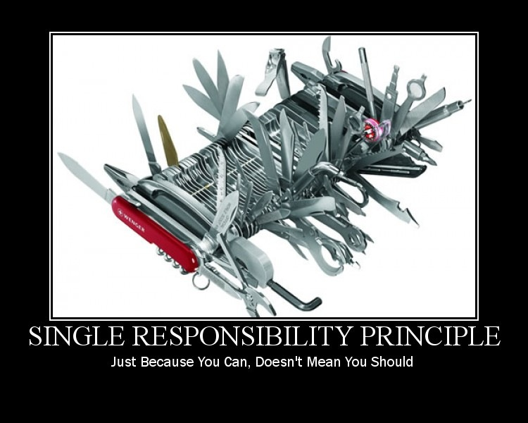
Single responsibility principle - Exercise

Slide 34
Open/closed principle
Software entities should be open for extension, but closed for modification
Closed for modification
Changing the behaviour of a class has an impact on the clients that use this class
Open for extension
Write code in a fashion that adding new functionality would involve minimal changes to existing code
Solution
Use abstractions: are fixed and represent an unbounded group of possible behaviours

Slide 35

Open/closed principle - Exercise

Slide 36
Liskov substitution principle
Derived types must be completely substitutable for their base types
Consume any implementation without changing the correctness of the system
Conditions
Method signature
Preconditions cannot be strengthened in a subtype
Postconditions cannot be weakened in a subtype
Invariants of the supertype must be preserved in a subtype
History constraint
Motivation
Unexpected behaviour may occur

Slide 37
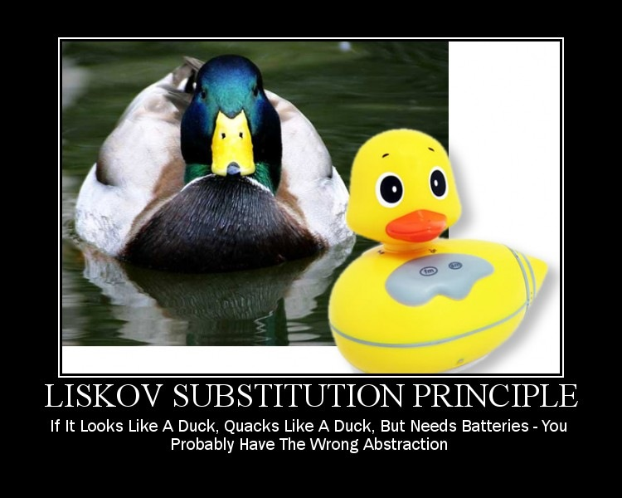
Liskov substitution principle - Exercise

Slide 38
Interface segregation principle
Clients should not be forced to depend on methods they do not use
Favour Role interfaces over Header interfaces
Motivation
Keep a system decoupled and thus easier to refactor, change, and redeploy
When clients are forced to depend upon interfaces that they don’t use, then those clients are subject to changes to those interfaces

Slide 39
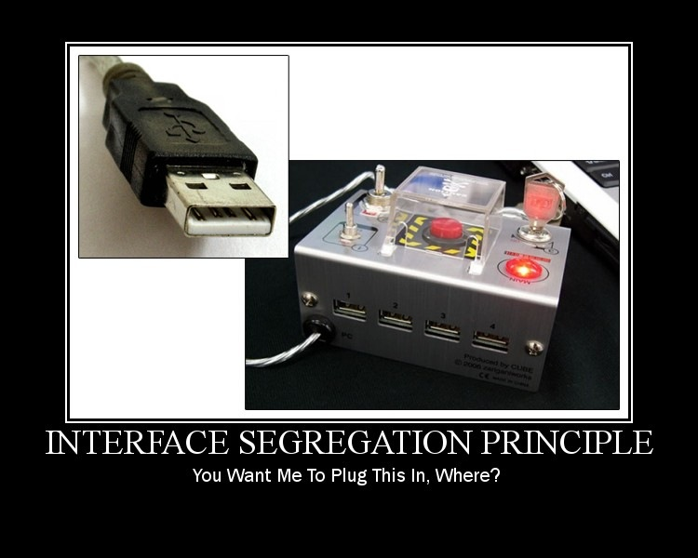
Interface segregation principle - Exercise

Slide 40
Dependency inversion principle
High-level modules should not depend on low-level modules. Both should depend on abstractions.
Abstractions should not depend upon details. Details should depend upon abstractions.
Solution
Define abstract interfaces for low level components
Resolve dependencies upon object construction (or use an IoC container)

Slide 41
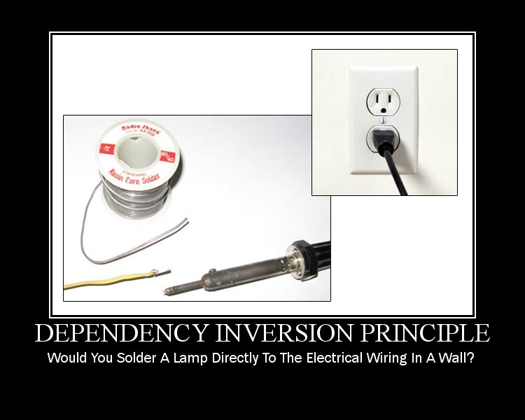
Dependency inversion principle - Exercise

Slide 42
Other principles
Object-Oriented Principles

Slide 43


Law of Demeter
this.attribute.foo();
methodParameter.foo();
foo(); // local method
A a = new A(); a.foo();
Global.foo(); // global
B b = this.attribute.getStranger();
b.foo();

Slide 44
Law of Demeter
Method m of an object O may only invoke the methods of the following kinds of objects:
O itself
m's parameters
Any objects created/instantiated within m
O's direct component objects
A global variable, accessible by O, in the scope of m
Motivation
Avoid needless, hidden dependencies
Maintainable and adaptable classes

Slide 45
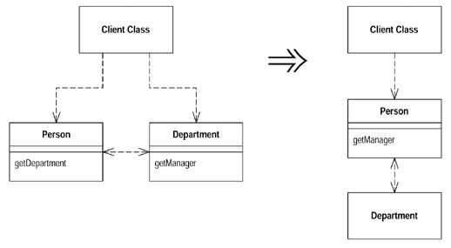
Law of Demeter

Slide 46
Tell, don’t ask principle
Object-orientation is about bundling data with the functions that operate on that data
Things that are tightly coupled should be in the same component
Check for cases where some code invokes more than one method on the same object
Do
Tell an object what to do
Don’t
Ask an object for data and act on that data

Slide 47
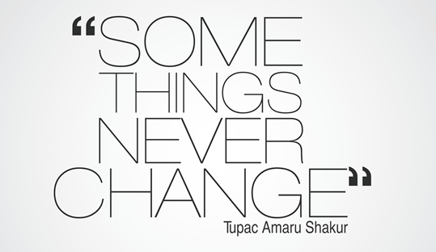
Immutable and Value objects
Immutable object
An object whose state cannot be modified after it is created
Are inherently thread-safe
Simpler to understand, Higher security
Drawback: copy-on-write
Value object
Equality is not based on identity
Should be immutable
Examples: Amount of money, Date range

Slide 48
Exercise - Length conversion problem
Accept lengths in either meters, inches (2.54 cm) or feet (0.3048 m), and provide ways to compare and convert freely between them
Feet
Meter
Inch

Slide 49

Exercise - Immutable
Make the Planet class immutable

Slide 50
Design by Contract
Viewing the relationship between a class and its clients as a formal agreement
Preconditions and postconditions
Assertion and violation
Class invariants
Client’s obligations
Supplier’s obligations
Inheritance

Slide 51
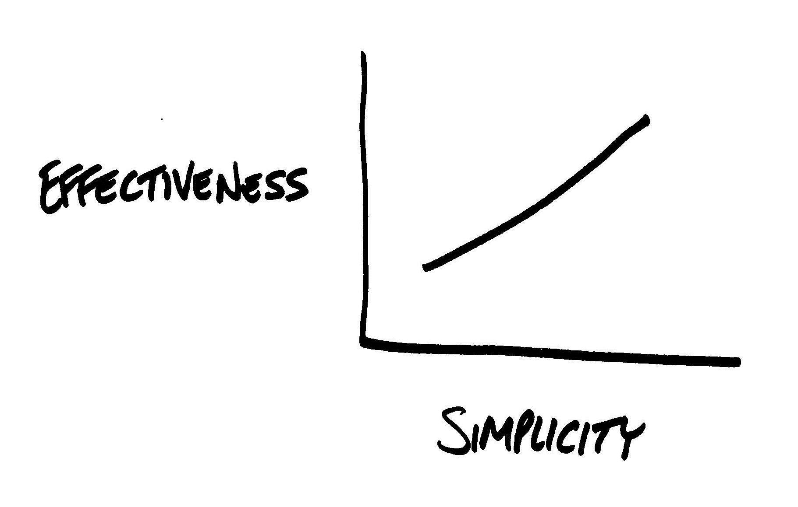
KISS
KISS – keep it simple
systems work best if they are kept simple rather than made complex
everything should be made as simple as possible, but no simpler (Albert Einstein)

Slide 52
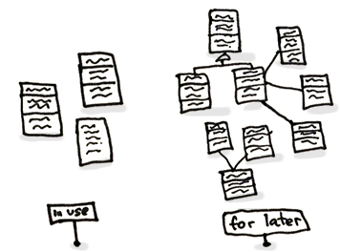
YAGNI
YAGNI - You ain't gonna need it
Should not add functionality until it is necessary
Instead spend time on testing

Slide 53

DRY
Don’t repeat yourself
Every piece of knowledge must have a single, unambiguous, authoritative representation within a system.

Slide 54
Packaging
Object-Oriented Principles

Slide 55
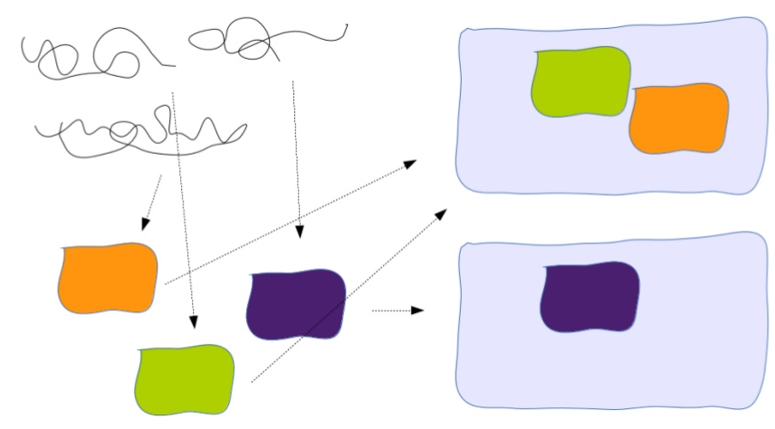
Packaging
Modules
Reduction of complexity
High cohesion, low coupling: for large-scale components

Slide 56
Principles of package cohesion
The Common Closure Principle
SRP for packages
The classes in a package should be closed together against the same kind of changes
A package should not have multiple reason to change
Maintainability may be more important than reusability
Reuse-release equivalence principle
The granule of reuse is the granule of release
Either all of the classes in a package are reusable or none of them are
Common-reuse principle
Classes that tend to be reused together belong in the same package
If you reuse one of the classes in a package, you reuse them all

Slide 57
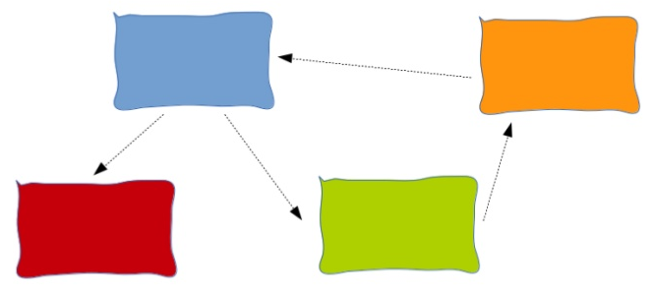
The Acyclic Dependencies Principle
Package graph should be DAG
Solutions
Apply dependency inversion principle
Create a new mediator package
Motivation
Packages in a cycle would become de facto a single package

Slide 58
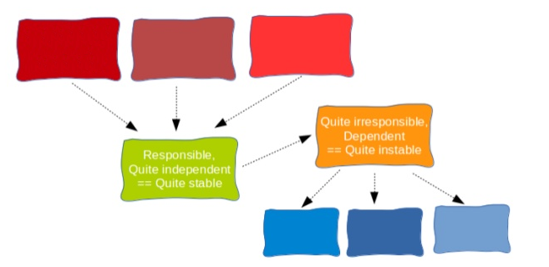
The Stable Dependencies Principle

Slide 59
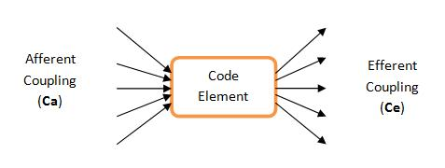
The Stable Dependencies Principle
Depend in the direction of stability
Metrics:
Afferent coupling (Ca), Efferent coupling (Ce)
Instability I = Ce / (Ca + Ce)
The I metrics of a package should be larger than the I metrics of the package that depends on

Slide 60
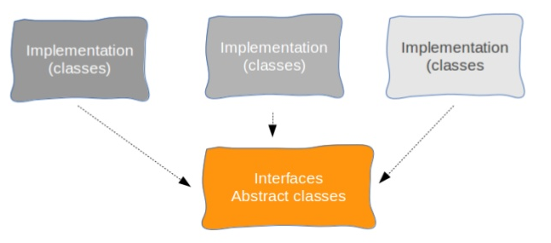
The Stable Abstractions Principle

Slide 61
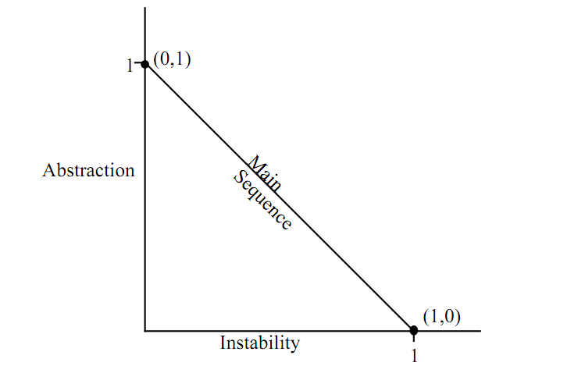
The Stable Abstractions Principle
A stable package should be abstract
An instable package should be concrete

Slide 62
Summary
Object-Oriented Principles

Slide 63
Summary
Core OO concepts
SOLID
Law of Demeter
Immutable and Value objects
Design by Contract
Packaging

